Slide 1
UNIT I
S.Hemalatha
AP(Sr.G)
Dept. of CA
KEC

Slide 2
Neural Network (NN)
A neural network is a machine learning program, or model, that makes decisions in a manner similar to the human brain, by using processes that mimic the way biological neurons works. These models consist of interconnected nodes or neurons that process data, learn patterns, and enable tasks such as pattern recognition and decision-making.
Neural networks are capable of learning and identifying patterns directly from data without pre-defined rules.
A biological neuron has a cell body or soma to process the impulses, dendrites to receive them, and an axon that transfers them to other neurons.

Slide 3
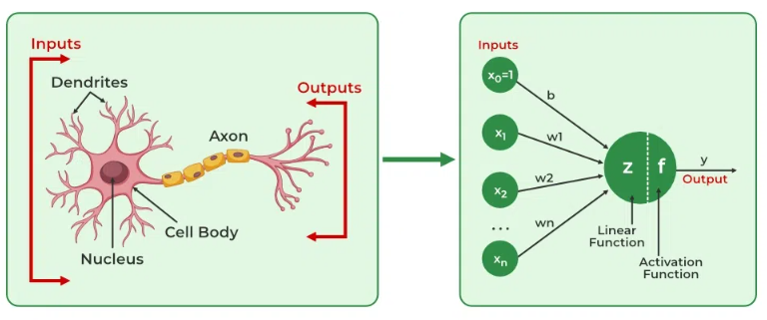
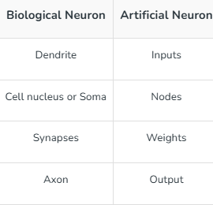
A Perceptron is an Artificial Neuron.
Working Principle:
Neuron receives inputs from dendrites.
If the total signal exceeds a certain threshold, the neuron fires (sends an output).
The signal travels down the axon to the next neuron.
In artificial neurons (ANNs), the concept of synapse is represented by a "weight".
When one artificial neuron connects to another, there is a weight on that connection.
That weight decides how strong the signal is — just like in a real synapse.

Slide 4

Artificial Neuron (Perceptron or Node)
Inspired by the biological neuron, the artificial neuron forms the core of an Artificial Neural Network (ANN).
Structure:
Inputs (x₁, x₂, ..., xₙ): Like dendrites.
Weights (w₁, w₂, ..., wₙ): Represents the importance of each input.
Bias (b): Extra parameter to adjust the output.
Summation: Computes a weighted sum of inputs.
Activation Function: Decides whether the neuron should "fire" (output).
f: activation function (step, sigmoid, ReLU, etc.)

Slide 5
A Perceptron
A perceptron is a fundamental building block of neural networks, designed to classify input data into two categories (binary classification). It works by taking multiple inputs, multiplying each by a corresponding weight, summing these weighted inputs, adding a bias, and then passing the result through an activation function (typically a step function) to produce a binary output (0 or 1).
Here's a breakdown of the process:
1. Inputs (x):
The perceptron receives multiple input values, each representing a feature of the data.
2. Weights (w):
Each input is associated with a weight, representing its importance in the decision-making process.
3. Weighted Sum:
The inputs are multiplied by their respective weights, and the products are summed up. This can be represented as ∑(wᵢ * xᵢ) where i ranges from 1 to the number of inputs.
4. Bias (b):
A bias term is added to the weighted sum. This allows the perceptron to learn even if all inputs are zero. The equation becomes ∑(wᵢ * xᵢ) + b.
5. Activation Function:
The result of the weighted sum plus bias is passed through an activation function. A common choice is the step function:
If the result is greater than or equal to 0, the output is 1.
If the result is less than 0, the output is 0.
6. Output (y):
The perceptron produces a binary output (0 or 1), representing the classification result.

Slide 6
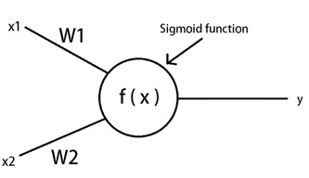
Perceptron
x1 and x2 are the two inputs. an integer , float etc.
for example , assume them as 1 and 0 respectively.
When these inputs pass through the connections ( through W1 and W2 ) , they are adjusted depending on the connection weights.
Let us assume that W1 = 0.5 and W2 = 0.6 ,
x1 * W1 + x2 * W2
= 1 * 0.5 + 0 * 0.6
= 0.5
Apply the simple sigmoid activation function .
f ( x ) = f ( 0.5 ) = 0.6224

Slide 7
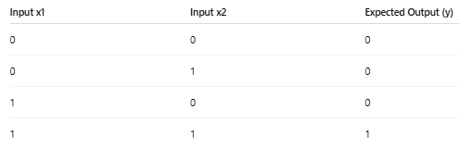

Training Step-by-Step (For first input [0, 0])
Let’s initialize:
w1 = 0, w2 = 0, b = 0
1st Sample: x1 = 0, x2 = 0, y = 0

Slide 8
np.insert(array, index, value) np.dot(a, b) import numpy as np
# Step 1: Define the activation function
# This is a step function: returns 1 if input is >= 0, else returns 0
def step_function(value):
return 1 if value >= 0 else 0
# Step 2: Create the Perceptron class
class Perceptron:
def __init__(self, input_size, learning_rate=0.1):
# Initialize weights (including one for bias)
self.weights = np.zeros(input_size + 1) # weights = [0.0, 0.0, 0.0]
self.learning_rate = learning_rate
# Method to make predictions
def predict(self, inputs):
# Add 1 at the beginning of input to represent bias input
inputs_with_bias = np.insert(inputs, 0, 1) # example : inputs = [0, 1] inputs_with_bias = [1, 0, 1]
# Calculate the weighted sum
total = np.dot(self.weights, inputs_with_bias)
# Apply step function to decide output
return step_function(total)
a = np.array([a1, a2, a3])
b = np.array([b1, b2, b3])
result = np.dot(a, b)
This gives:
result = a1*b1 + a2*b2 + a3*b3

Slide 9
# Method to train the perceptron
def train(self, X, y, epochs=10):
for epoch in range(epochs):
print(f"Epoch {epoch+1}")
for i in range(len(X)):
prediction = self.predict(X[i]) # Predict output
error = y[i] - prediction # Calculate error
x_with_bias = np.insert(X[i], 0, 1) # Add bias input
# Update weights using learning rule
self.weights += self.learning_rate * error * x_with_bias
print(f" Input: {X[i]}, Predicted: {prediction}, Actual: {y[i]}, Updated Weights: {self.weights}")
# Step 3: Example usage
if __name__ == "__main__":
# Training data for OR logic gate
X = np.array([
[0, 0],
[0, 1],
[1, 0],
[1, 1]
])
y = np.array([0, 1, 1, 1]) # Correct output of OR gate
Weight Update Rule in Perceptron
In your training loop:
self.weights += self.lr * error * x_with_bias
# Step 4: Create perceptron and train it
perceptron = Perceptron(input_size=2)
perceptron.train(X, y, epochs=10)
# Step 5: Test the trained perceptron
print("\nFinal Predictions:")
for x in X:
output = perceptron.predict(x)
print(f"Input: {x}, Predicted Output: {output}")

Slide 10
Key terms
1. Bias
Bias is an extra constant added to the weighted sum of inputs before applying the activation function.
It allows the model to shift the decision boundary (like the "intercept" in a straight line y = mx + b).
Without bias, the model would always have to pass through the origin (0,0), limiting flexibility.
2. Weights
Weights are multipliers applied to each input feature.
They determine how important each input is in predicting the output.
Example:
output = weight1 * input1 + weight2 * input2 + bias
3. Learning Rate (η)
The learning rate controls how big the step is when updating the weights during training.
A small value = slow learning; large value = faster but risk of overshooting. defined before training (like learning rate, epochs)
Example: new_weight = old_weight + learning_rate × error × input
4. Training
Training is the process of teaching the model by showing it examples (inputs with correct outputs).
During training, the model:
Makes predictions
Compares predictions to actual output (using loss)
Updates weights and bias to reduce error
5. Compile (in Keras/TensorFlow)
model.compile() is a function to set:
Loss function (how to measure error)
Optimizer (how to update weights)
Metrics (what performance to track)
model.compile(loss='binary_crossentropy', optimizer='adam', metrics=['accuracy'])
6. Loss Function
A loss function tells the model how wrong its prediction is.
Goal of training: minimize loss

Slide 11
Bias – to understand
:Making Tea with a Gas Stove
To make tea, you need to turn the gas knob.
But you can’t just lightly touch it — you must turn it past a certain point before the flame turns on.
That initial push you need before the gas stove lights up
The ingredients (milk, tea, sugar) are like the inputs x1,x2,x3.
The heat (final output) depends on how you mix the ingredients AND whether the flame turns on.
Even if the ingredients are correct, the stove won’t light unless you pass a minimum threshold — that’s the bias.
In Neural Networks:
Bias lets the model "ignite" or activate even when the weighted inputs are small or zero.
Without it, the neuron is like a stove that can only turn on if inputs are perfect, which is very limiting.

Slide 12
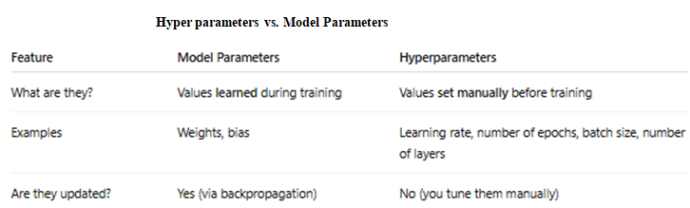
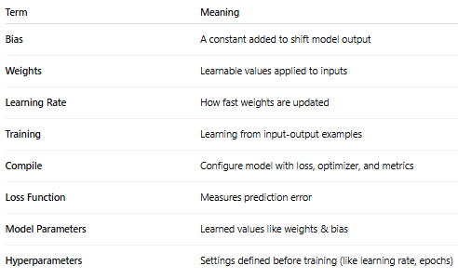

Slide 13

A threshold value is a cut-off point the model uses to decide:
Should the output be 1 (yes) or 0 (no)?
You need at least 40 marks to pass.
Here, 40 is the threshold.
If you score 45 → you pass (1) If you score 35 → you fail (0)
Does the activation function decide the threshold?
Yes — in many simple models like a perceptron, the activation function (like the step function) implicitly includes the threshold.
Example: Step Function
def step_function(x): return 1 if x >= 0 else 0
In this function, the threshold is 0 — it's built into the function.
So:
If x ≥ 0 → Output is 1
If x < 0 → Output is 0
That means: you don't need to set the threshold separately — it's already part of the activation function.
When do we set threshold separately?
Only in some custom or complex models, you might want to set the threshold manually. For example:
threshold = 0.5 output = 1 if total >= threshold else 0
This might be used when you're using sigmoid or other continuous activation functions.
Example with Sigmoid Activation:
def sigmoid(x): return 1 / (1 + np.exp(-x))
Sigmoid gives an output between 0 and 1 (like a probability). So we often use a threshold like:
output = 1 if sigmoid(x) >= 0.5 else 0
Here, threshold 0.5 is fixed manually.

Slide 14
Artificial Neural Network (ANN)
How Neurons Work in an Artificial Neural Network (ANN)
An ANN consists of layers of artificial neurons:
Layers in a Neural Network:
Input Layer: Accepts input features (like image pixels, sensor values).
Hidden Layers: Process inputs through multiple neurons and non-linear functions.
Output Layer: Produces final prediction or classification.
Working Process of ANN:
Forward Propagation: the data flows from the input layer to the output layer, passing through any hidden layers. Each neuron in the hidden layers processes the input as follows:
Each neuron computes a weighted sum.
Activation function determines neuron output.
The output is passed to the next layer.
Loss Calculation:
Once the network generates an output, the next step is to calculate the loss using a loss function (Compares the predicted output with actual output (ground truth).)
Computes an error (loss function like MSE ( mean squared error) for regression, cross-entropy for classification).
Backpropagation:
The goal of training an MLP is to minimize the loss function by adjusting the network's weights and biases. This is achieved through backpropagation:
Adjusts weights and bias to reduce error.
Uses optimization techniques (e.g., gradient descent).

Slide 15
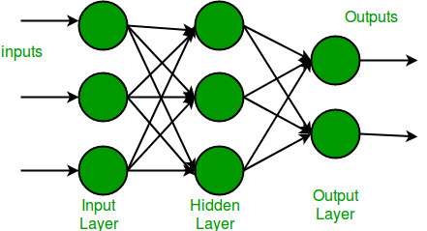
Multi-Layer Perceptron Learning in Tensorflow
Multi-Layer Perceptron (MLP) or feed-forward neural network architecture consists of fully connected dense layers that transform input data from one dimension to another. It is called multi-layer because it contains an input layer, one or more hidden layers and an output layer. The purpose of an MLP is to model complex relationships between inputs and outputs.
Components of Multi-Layer Perceptron (MLP)
Input Layer: Each neuron or node in this layer corresponds to an input feature. For instance, if you have three input features the input layer will have three neurons.
Hidden Layers: MLP can have any number of hidden layers with each layer containing any number of nodes. These layers process the information received from the input layer.
Output Layer: The output layer generates the final prediction or result. If there are multiple outputs, the output layer will have a corresponding number of neurons.

Slide 16
Every neural network consists of layers of nodes or artificial neurons, an input layer, one or more hidden layers, and an output layer. Each node connects to others, and has its own associated weight and threshold. If the output of any individual node is above the specified threshold value, that node is activated, sending data to the next layer of the network. Otherwise, no data is passed along to the next layer of the network.
Neural networks rely on training data to learn and improve their accuracy over time. Once they are fine-tuned for accuracy, they are powerful tools in computer science and artificial intelligence, allowing us to classify and cluster data at a high velocity. Tasks in speech recognition or image recognition can take minutes versus hours when compared to the manual identification by human experts. One of the best-known examples of a neural network is Google’s search algorithm.
Neural networks are sometimes called artificial neural networks (ANNs) or simulated neural networks (SNNs). They are a subset of machine learning, and at the heart of deep learning models.

Slide 17


Slide 18
Common Architectural Principles of Deep Networks
Core components:
Parameters
Layers
Activation functions
Loss functions
Optimization methods
Hyperparameters
Building block networks of deep networks, such as the following:
RBMs
Autoencoders
specific deep network architectures:
UPNs
CNNs
Recurrent neural networks
Recursive neural networks

Slide 19
Parameters and Hyperparameters
In ML/DL, a model is defined or represented by the model parameters.
However, the process of training a model involves choosing the optimal hyperparameters that the learning algorithm will use to learn the optimal parameters that correctly map the input features (independent variables) to the labels or targets (dependent variable) such that you achieve some form of intelligence.

Slide 20
Model Parameters
Parameters are internal to the model. That is, they are learned or estimated purely from the data during training as the algorithm used tries to learn the mapping between the input features and the labels or targets.
Model parameters are learned by the model automatically during training. These are the values the model adjusts to fit the data.
Purpose:
They define the behavior of the model during prediction. They change as the model trains, improving the model’s accuracy.
Examples:
Let’s take a simple model like Linear Regression: y=w⋅x+b
Here:
w (weight) and b (bias) are model parameters.
The model adjusts these values based on training data to reduce error.
In Deep Learning (Neural Network):
Weights and biases in each layer are model parameters.
These are updated during backpropagation using the optimizer (like SGD or Adam).

Slide 21
Hyperparameters
Hyperparameters are parameters whose values control the learning process and determine the values of model parameters.
Hyperparameters are set before training and not learned by the model. They control the learning process.
Purpose: They affect how well the model learns, how fast it converges, and whether it overfits or underfits.
Examples:
Learning Rate – Controls how much weights are updated per step.
Batch Size – Number of training samples in one forward/backward pass.
Number of Epochs – How many times the full dataset is passed through the model.
Number of Hidden Layers/Units or layer size– Controls network architecture.
Activation Function – Like ReLU, Sigmoid, etc.
Dropout Rate – Prevents overfitting by randomly turning off neurons.
•

Slide 22
Creating a simple Multilayer Neural Network (MLP) in Keras (with TensorFlow backend)
Using Sequential API (most beginner-friendly)
from tensorflow.keras.models import Sequential
from tensorflow.keras.layers import Dense
# Create a simple model
model = Sequential([
Dense(64, activation='relu', input_shape=(input_dim,)), # input layer
Dense(32, activation='relu'), # hidden layer
Dense(1, activation='sigmoid') # output layer
])

Slide 23
Explanation:
Dense(64, activation='relu', input_shape=(input_dim,)),
Sequential: Used to build models layer-by-layer (in a linear stack).
Dense: Adds fully connected (dense) layers to the model.
Layer 1: Input + First Hidden Layer
input_dim is the number of features in your dataset (e.g., 13 for UCI Heart dataset).
Example: input_shape=(13,)
Take 13 features as input, fully connect them to 64 neurons, apply ReLU to each neuron's output.
Dense(32, activation='relu'),
Another fully connected layer with 32 neurons.
Also uses ReLU activation.
Learns more complex patterns from the previous layer’s output.
Dense(1, activation='sigmoid')
Final layer with 1 neuron.
Activation = sigmoid, which outputs a value between 0 and 1.
Perfect for binary classification problems (e.g., heart disease: yes/no).

Slide 24
Using Functional API (more flexible for complex models)
from tensorflow.keras.models import Model
from tensorflow.keras.layers import Input, Dense
# Define input
inputs = Input(shape=(input_dim,))
x = Dense(64, activation='relu')(inputs)
x = Dense(32, activation='relu')(x)
outputs = Dense(1, activation='sigmoid')(x)
# Create model
model = Model(inputs=inputs, outputs=outputs)
model.compile(optimizer='adam',
loss='binary_crossentropy',
metrics=['accuracy'])
model.fit(X_train, y_train, epochs=10, batch_size=32, validation_split=0.2)
model.compile(: prepares the model for training by configuring the optimization algorithm, loss function, and evaluation metrics.
model.fit(...) : This line trains the model using the training data.

Slide 25
Example:
from tensorflow.keras.models import Sequential
from tensorflow.keras.layers import Dense
model = Sequential()
model.add(Dense(128, activation='relu')) # 128 units/no.of neurons → hyperparameter
model.add(Dropout(0.3)) # 0.3 dropout rate → hyperparameter
model.compile(optimizer='adam', # optimizer type → hyperparameter
loss='categorical_crossentropy',
metrics=['accuracy'])
model.fit(X_train, y_train, epochs=10, # 10 epochs → hyperparameter
batch_size=32) # batch size → hyperparameter
“128" means the number of neurons in that layer, and each neuron learns a part of the data representation.
Suppose the previous layer has 64 outputs (features). Then:
Each of the 128 neurons will have 64 weights + 1 bias.
So, this layer will have:
(64 + 1) × 128 = 8320 parameters
These are the. trainable parameters. (model parameters)

Slide 26
set the hyperparameters before training begins and the learning algorithm uses them to learn the parameters.
setting the right hyperparameter values is very important because it directly impacts the performance of the model that will result from them being used during model training.
The process of choosing the best hyperparameters for your model is called hyperparameter tuning.
Or
Hyperparameter tuning is the process of finding the best combination of these settings to improve model performance.

Slide 27
(As per the reference Book content)
Layer size : defined by the number of neurons in a given layer. For the input layer, this will match up to the number of features in the input vector. For the output layer, this will either be a single output neuron or a number of neurons matching the number of classes we are trying to predict.
• Magnitude (momentum, learning rate)
• Regularization (dropout, drop connect, L1, L2)
• Activations (and activation function families)
• Weight initialization strategy
• Loss functions
• Settings for epochs during training (mini-batch size)
• Normalization scheme for input data (vectorization)

Slide 28
1. Learning Rate (lr)
Controls how big a step the model takes to adjust weights during training.
Too small: Training is slow.
Too big: Model might overshoot and never learn properly.
Example:
optimizer = Adam(learning_rate=0.001)
0.001 is a common default. You can try 0.01, 0.0001, etc.
2. Batch Size
The number of samples the model sees at one time before updating weights.
Small batch size = slower training, better generalization
Large batch size = faster training, more memory use
Example:
model.fit(X_train, y_train, batch_size=32)
32 samples are used in one training step.

Slide 29
3. Epochs
One epoch = one complete pass through the entire training dataset.
More epochs → better learning (up to a point)
Too many → model may overfit
Example:
model.fit(X_train, y_train, epochs=20)
Model sees the entire dataset 20 times during training.
4. Number of Neurons (Units) in a Layer or layer size:
Number of processing units (neurons) in a layer.
Too few → underfitting
Too many → overfitting or unnecessary complexity
Example:
model.add(Dense(128, activation='relu'))
Adds a layer with 128 neurons.
Layer size : defined by the number of neurons in a given layer For the input layer, this will match up to the
number of features in the input vector. For the output layer, this will either be a single output neuron or a number of neurons matching the number of classes trying to predict.

Slide 30
5. Number of Hidden Layers
Number of layers between input and output layers.
More layers → model can learn more complex patterns
But may be slower and risk overfitting
Example:
model = Sequential() model.add(Dense(64, activation='relu')) model.add(Dense(32, activation='relu')) # 2 hidden layers
6. Activation Function
A function that decides whether a neuron should be activated or not.
Helps model learn non-linear patterns.
Common types:
ReLU, Sigmoid, Tanh, Softmax
Example:
model.add(Dense(128, activation='relu'))

Slide 31
Regularization Techniques
Regularization is a technique used in deep learning (and machine learning) to prevent overfitting.
Overfitting happens when a model learns the training data too well, including its noise and random fluctuations, and performs poorly on unseen data.
Regularization adds a penalty to the loss function to discourage the model from learning overly complex patterns (which often means memorizing the training data).
Common Regularization Techniques:
L1(Lasso) and L2(Ridge) Regularization (Weight Penalties), Dropout, Early Stopping, Data Augmentation

Slide 32
7. Dropout Rate
Fraction of neurons randomly turned off during training
Dropout is a regularization technique used in deep learning to prevent overfitting.
Prevents the model from memorizing the training data.
Dropout is turned off during evaluation and prediction
during training with dropout, it is completely possible that even a neuron that contributes a lot to correct prediction might be temporarily dropped.
The network cannot rely too much on any one neuron.
So, it learns redundant representations — i.e., multiple neurons learn to represent the same information in different ways.
If an important neuron is dropped:
The model may do slightly worse on that batch.
But in the long run, the model becomes stronger and more general, because it:
Doesn’t overfit to one pattern
Learns to use multiple features for the same prediction
Example:
model.add(Dropout(0.3))
Randomly turns off 30% of the neurons during training.
Drop connect: Weights (individual links)
Similar to Dropout, but instead of dropping entire neurons, DropConnect randomly removes individual weights during training.
DropConnect is more advanced and less common than Dropout, but it may provide stronger regularization.

Slide 33
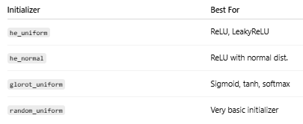
8. Optimizer
Algorithm that adjusts the model's weights during training to reduce error.
Common types:
SGD (Stochastic Gradient Descent), Adam, RMSprop
Example:
model.compile(optimizer='adam', loss='categorical_crossentropy')
9. Loss Function
A function that tells how wrong the model is. The model tries to minimize this value.
Depends on the task:
Classification: categorical_crossentropy, binary_crossentropy
Regression: mean_squared_error
Example:
model.compile(loss='categorical_crossentropy')
10. Weight Initialization Method
Method to set the initial weights before training starts.
Bad initialization → slow or failed training
Example:
model.add(Dense(128, kernel_initializer='he_uniform'))

Slide 34
Momentum
Momentum is a gradient descent optimization approach that adds a percentage of the prior update vector to the current update vector to speed up the learning.
What is Momentum?
Momentum is a concept from physics where an object’s motion depends not only on the current force but also on its previous velocity.
Momentum is a technique used to speed up the training of a neural network by helping it move faster in the right direction and avoid getting stuck.

Slide 35


What is Regularization?
It is a technique to keep the model simple by discouraging large weights.
Too large weights = too complex model = may memorize training data.
L1 Regularization (Lasso):
Adds the sum of absolute values of weights to the loss
Encourages sparsity (many weights become exactly zero)
Result: the model may ignore unimportant features
L2 Regularization (Ridge):
Adds the sum of squares of the weights to the loss
Encourages small weights (not zero, but close to 0)
Makes the model smoother and prevents extreme values

Slide 36
Overfitting, underfitting, good fit
Overfitting
The model learns too much — including noise and irrelevant patterns in the training data.
Training accuracy: Very high
Validation/Test accuracy: Poor
The model is memorizing instead of learning
Underfitting
The model learns too little — it fails to capture the underlying patterns.
Training accuracy: Low
Validation/Test accuracy: Low
The model is too simple or not trained well enough
Good Fit
The model learns just enough — it generalizes well to new data.
Training accuracy: High
Validation/Test accuracy: High
The model captures the true patterns without memorizing noise

Slide 37
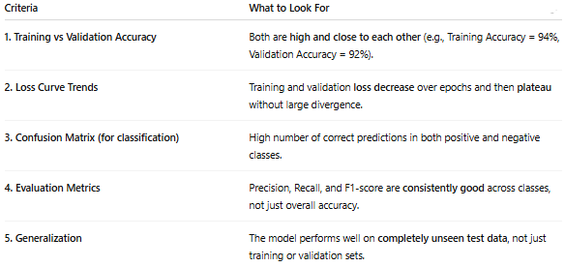
plateau" means that a value (like loss or accuracy) stops changing significantly over time (usually over epochs) and stays relatively flat
Overfitting: High training accuracy (e.g., 98%) but low validation/test accuracy (e.g., 70%).
Underfitting: Both training and validation accuracy are low (e.g., below 70%), indicating the model is too simple or not learning.
Epoch: 1 2 3 4 5 6 7 8 9 10
Loss: 0.8 0.6 0.5 0.4 0.38 0.37 0.36 0.36 0.35 0.35
From Epoch 1 to 5, the loss decreases clearly. From Epoch 6 onward, the loss is almost not changing — this is the plateau.

Slide 38
Example
COVID Test Result
“Yes” = Person has COVID
“No” = Person does NOT have COVID
understand the four parts:
True Positive (TP):
The test says you have COVID, and you actually do.
Test is correct, caught the disease.
True Negative (TN):
The test says you don’t have COVID, and you actually don’t.
Test is correct, and you're healthy.
False Positive (FP):
The test says you have COVID, but you don’t.
Test is wrong — causes unnecessary panic and isolation.
False Negative (FN):
The test says you don’t have COVID, but you do.
Test is wrong — dangerous because you might unknowingly infect others.

Slide 39
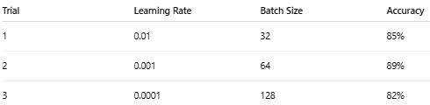
Hyperparameter Tuning
Hyperparameter tuning is the process of finding the best values for the hyperparameters to improve the model’s performance.
Try different combinations (like learning rate, batch size, number of layers, etc.) and choose the one that gives the best accuracy or lowest loss on validation data.

Slide 40
Methods of hyperparameter tuning
1. Manual Search:
You try different values manually (like in the table above).
2. Grid Search:
Try all combinations of given hyperparameter values. define a grid (table) of all possible combinations of hyperparameter values, and the model tries every combination.
Systematic and thorough but Very slow and Computationally expensive
Example
Learning rate: [0.1, 0.01]
Batch size: [32, 64]
Grid search will try:
lr = 0.1, batch = 32
lr = 0.1, batch = 64
lr = 0.01, batch = 32
lr = 0.01, batch = 64

Slide 41
3. Random Search:
Instead of trying all combinations, it randomly selects a few combinations to try..
Faster than grid search but May miss the best combination and Results can vary each time
Example
Learning rate: [0.1, 0.01, 0.001, 0.0001]
Batch size: [16, 32, 64, 128]
Instead of trying 16 combinations, Random Search might try just 5 random ones.
4. Automated Tuning Tools:
Instead of random trial and error, this method learns from past trials and intelligently selects the next set of hyperparameters to try. Tools like: Keras Tuner, Optuna, Ray Tune, Hyperopt
These methods:
Keep track of what hyperparameters they have tried already.
Analyze the results (accuracy, loss) from each trial.
Use that knowledge to guess better values next time.
Example: Let’s say you're tuning the learning rate and number of units in a layer.
Trial 1: Tries learning rate = 0.01 → accuracy = 75%
Trial 2: Tries learning rate = 0.001 → accuracy = 85%
The tuner learns that 0.001 is better than 0.01, so it tries values near 0.001 next time (like 0.0005 or 0.002)
So, it’s not guessing blindly — it’s learning from experience.

Slide 42
Gridsearch
from sklearn.model_selection import GridSearchCV
from sklearn.neural_network import MLPClassifier
param_grid = {
'learning_rate_init': [0.1, 0.01],
'batch_size': [32, 64]
}
grid = GridSearchCV(MLPClassifier(), param_grid, cv=3)
grid.fit(X_train, y_train)
print(grid.best_params_)
Grid search will try:
lr = 0.1, batch = 32
lr = 0.1, batch = 64
lr = 0.01, batch = 32
lr = 0.01, batch = 64

Slide 43
Random search
from sklearn.model_selection import RandomizedSearchCV
from sklearn.neural_network import MLPClassifier
from scipy.stats import uniform
param_dist = {
'learning_rate_init': uniform(0.0001, 0.01),
'batch_size': [32, 64, 128]
}
rand_search = RandomizedSearchCV(MLPClassifier(), param_dist, n_iter=5)
rand_search.fit(X_train, y_train)
print(rand_search.best_params_)

Slide 44
Automated Tuning Tools
from keras_tuner import RandomSearch
def build_model(hp):
model = Sequential()
model.add(Dense(units=hp.Int('units', 32, 128, step=32), activation='relu'))
model.add(Dense(10, activation='softmax'))
model.compile(optimizer='adam',
loss='sparse_categorical_crossentropy',
metrics=['accuracy'])
return model
tuner = RandomSearch(build_model,
objective='val_accuracy',
max_trials=5)
tuner.search(X_train, y_train, epochs=10, validation_split=0.2)
Efficient and smarter than Grid/Random, Finds good solutions with fewer trials But More complex and May need more setup and packages
Here, hp.Int('units', 32, 128, step=32) → tuner will try units = 32, 64, 96, 128.

Slide 45
hyperparameter
Question: A student trains two neural network models on the same dataset.
Model A uses a learning rate of 0.01 and trains for 10 epochs.
Model B uses a learning rate of 0.5 and trains for 100 epochs. Model B gives poor accuracy and unstable results, while Model A performs better and converges smoothly.
Q: Based on the above situation, what might be the reason for Model B’s poor performance? Briefly explain.
Model B likely has a poor choice of hyperparameters. A high learning rate (0.5) may cause the model to overshoot optimal weights, and too many epochs can lead to overfitting. Proper tuning of hyperparameters like learning rate and epochs is important for stable and accurate learning.

Slide 46
Scenario-Based
Two students are building neural networks for the same task.
One student chooses 3 hidden layers with ReLU.
The other chooses 2 hidden layers with sigmoid activation.
They wonder why their models behave differently even though the dataset is the same.
Q: What kind of settings have they changed — and what are such settings called in machine learning?
They changed the hyperparameters (layer count and activation function), which are set before training and define the model's architecture and learning behavior.
Multiple Model Designs
A data scientist designs two deep learning models with the following differences:
Model X: ReLU activation, deeper architecture
Model Y: Sigmoid activation, fewer layers
Q: Are these differences related to hyperparameters or parameters learned during training? Explain briefly.
These are hyperparameter choices made before training. They define how the model is built and trained, not values learned from data.
Student Conversation
Student A: “I trained my model with 3 hidden layers using ReLU.” Student B: “I used only 2 layers and sigmoid. Our results are different!”
Q: What type of configuration did they change? Are these adjusted during or before training?
They changed hyperparameters (layer count and activation function), which are set before training.

Slide 47
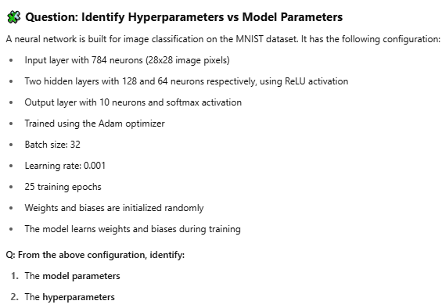

Slide 48
Activation Function - ReLU
A neural network layer uses the activation function A(x)=max(0,x) When the input values are:
x1=−3→ Output: 0
x2=2.5→ Output: 2.5
Q: Why does the output behave differently for x1​ and x2​? Because the activation function is ReLU, it outputs 0 for any negative input and passes positive inputs as-is. Hence, x1=−3 gives 0, and x2=2.5 gives 2.5.
Question 2:
For the activation function shown in the diagram, an input of x=−7 gives an output of 0. Q: What type of values will always result in 0 output for this function?
Any input value that is less than or equal to 0 will result in an output of 0 because the function takes the maximum between 0 and the input.
Question 3:
In a neural network, an activation layer shows these outputs:
Input: −5, Output: 0
Input: 0, Output: 0
Input: 3.1, Output: 3.1
Q: What kind of function is likely used here and how does it treat negative values?
The function is likely ReLU, which removes negative values by converting them to 0 while keeping positive values unchanged.

Slide 49
Overfitting and underfitting
A student trains two different neural network models to classify handwritten digits:
Model A performs very well on the training set (98% accuracy) but gives only 60% accuracy on the test set.
Model B performs poorly on both training (65%) and test sets (63%).
Q: Identify which model is overfitting and which is underfitting. Justify your answer briefly.
Model A is overfitting because it learns the training data very well but fails to generalize to unseen data.
Model B is underfitting because it performs poorly on both training and test sets, indicating it hasn’t learned the data well.
Question 3: You trained a shallow neural network on a complex image dataset, and it achieves the result of Training Accuracy: 58% and Test Accuracy: 57%
Q: What is the issue here, and how can it be improved? This is underfitting — the model is too simple for the data. Use a deeper network or train longer to improve learning.
Question 4: Afer adding more layers to your network, you notice the training accuracy increases, but the validation accuracy drops.
Q: What is likely happening in the model? The model is likely overfitting due to increased complexity, capturing noise from the training data.
Question 5:
A model is trained on a large dataset but shows almost equal and low accuracy on both training and test sets.
Q: Is this overfitting or underfitting? Suggest a simple solution. This is underfitting. The model may need to be more complex or trained for more epochs to capture patterns.
Question 6:
A student says, “I want my model to perform well only on training data.” What potential issue might arise from this approach?
The model may overfit, meaning it will fail to generalize and perform poorly on new or unseen data.

Slide 50
Loss function
A student trains a neural network for binary classification. After each epoch, the student observes that the predicted outputs are very close to the true labels, and the value of the loss keeps decreasing slowly. Another student asks, “Why do we calculate the loss if the accuracy is already high?”
As the student, explain what the loss function represents and why it is still important during training, even when accuracy seems good.
The loss function measures how far the model’s predictions are from the actual values in numerical terms. Even if accuracy is high, a lower loss means the predictions are more confident and precise, helping the model learn better during training.
Question: During training, a model's accuracy improves slightly, but the loss value decreases significantly. Another student asks: "If accuracy is already good, why do we still look at the loss?"
Q: Based on this situation, explain why the loss function is important, even when the accuracy is high.
The loss function gives a detailed view of how confident and close the predictions are to the actual values. Even if accuracy is high, a lower loss means the model is making more precise predictions, which helps in better training and generalization.
A student says, "My model correctly predicted 8 out of 10 test samples. So, do I still need to look at the loss?"
Q: How would you explain the role of the loss function in this case?
Yes, because the loss function tells how close or confident the predictions are, not just whether they're right or wrong. It helps improve the model's learning even when accuracy seems good.

Slide 51
Question 3: Prediction confidence
Two models predict binary labels for the same input:
Model A predicts: [0.9, 0.8, 0.1, 0.05]
Model B predicts: [0.6, 0.6, 0.4, 0.3] Both give the same accuracy when thresholded at 0.5. Q: Which model has a better loss, and why?
Model A has a better (lower) loss because it is more confident and closer to the true labels. Loss measures how sure the predictions are, not just correct labels.
Question 4: Role of loss during training
After 50 epochs, the training accuracy plateaus but the loss still decreases. Q: What does this indicate about the model's learning?
It means the model is still improving in prediction precision, even if accuracy is unchanged. Loss is sensitive to small prediction errors, so it reflects fine-tuning of the model.
Question 5: Regression context
In a regression model, the predicted values are close to the target but not exact. Q:Why is loss function (like MSE) important in regression problems?
Loss functions like MSE measure how far predicted values are from actual targets, helping the model learn to minimize those differences. Accuracy alone doesn’t apply to regression.
Question 6: Comparing models
Two students use different loss functions for the same classification task: one uses cross-entropy, the other uses mean squared error (MSE). Q: Why might their models learn differently even with the same dataset?
Different loss functions guide the model in different ways. Cross-entropy is better for classification as it handles probabilities, while MSE is suited for regression. The choice affects learning behavior.

Slide 52
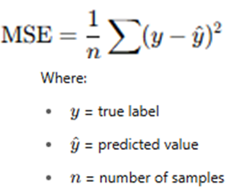
Question 3: with a simple loss function — the Mean Squared Error (MSE) — to compare Model A and Model B step-by-step.
Assume the True Labels:
For simplicity, assume the correct binary labels for the 4 samples are:
True Labels=[1,1,0,0]
Model Predictions:
Model A predicts: [0.9, 0.8, 0.1, 0.05]
Model B predicts: [0.6, 0.6, 0.4, 0.3]
Both models give correct classifications when thresholded at 0.5:
If predicted ≥ 0.5 → class 1
If predicted < 0.5 → class 0
So:
Model A predicts [1, 1, 0, 0]
Model B predicts [1, 1, 0, 0]
Same accuracy = 100%
MSE Formula:

Slide 53
Sample | True (y) | Predicted (ŷ) | (y - ŷ)²
1 | 1 | 0.9 | (1 - 0.9)² = 0.01
2 | 1 | 0.8 | (1 - 0.8)² = 0.04
3 | 0 | 0.1 | (0 - 0.1)² = 0.01
4 | 0 | 0.05 | (0 - 0.05)² = 0.0025
MSE_{A} =(0.01+0.04+0.01+0.0025​)/4
=0.0625​/4
=0.015625
Sample | True (y) | Predicted (ŷ) | (y - ŷ)²
1 | 1 | 0.6 | (1 - 0.6)² = 0.16
2 | 1 | 0.6 | (1 - 0.6)² = 0.16
3 | 0 | 0.4 | (0 - 0.4)² = 0.16
4 | 0 | 0.3 | (0 - 0.3)² = 0.09
MSE_{B}​ =(0.16+0.16+0.16+0.09​)/4
=0.57​/4
=0.1425
Model | MSE (Loss)
Model A | 0.015625 - Lower
Model B | 0.1425 - Higher
Even though both models get the labels right after thresholding (accuracy is same), Model A makes predictions that are much closer to the true values, resulting in a lower loss.
That’s why Model A is better in terms of loss.

Slide 54
Steps to create a simple neural network
Import necessary libraries, primarily TensorFlow and Keras, along with other required packages such as NumPy and Pandas for data handling.
Create or load a dataset. Convert the data into a format suitable for training (usually NumPy arrays).
Define features (X) and labels (y).
Create a Neural Network :
Instantiate a Sequential model and add layers. The input layer and hidden layers are typically created using Dense layers, specifying the number of neurons and activation functions.
Compile the model by specifying the loss function, optimizer, and metrics to evaluate during training.
Fit the model on the training data, specifying the number of epochs and batch size. This step trains the neural network to learn from the input data.
Use the trained model to make predictions on new data. Process the output to interpret the predictions (e.g., convert probabilities to binary outcomes).

Slide 55
NumPy Array (np.array)
A NumPy array is a fast, memory-efficient homogeneous multidimensional container for numerical data.
Pandas DataFrame (pd.DataFrame)
A DataFrame is a 2D tabular structure with labeled rows and columns (like an Excel sheet), built on top of NumPy arrays.
Use NumPy arrays when you are doing numerical computation, like matrix operations or feeding tensors to neural networks.
Use pandas DataFrames when working with tabular datasets, such as CSV files or database exports.
TensorFlow
TensorFlow is an open-source deep learning framework developed by Google. It provides tools to build and train machine learning and deep learning models.
Keras
Keras is a high-level API built on top of TensorFlow. It allows you to easily define and train deep learning models with fewer lines of code.
A framework like TensorFlow is a big library system that may include many small libraries inside it (like Keras).

Slide 56
Implementation of Neural Network using TensorFlow
import numpy as np
import pandas as pd
from tensorflow.keras.models import Sequential
from tensorflow.keras.layers import Dense
data = {
'feature1': [0.1, 0.2, 0.3, 0.4, 0.5],
'feature2': [0.5, 0.4, 0.3, 0.2, 0.1],
'label': [0, 0, 1, 1, 1]
}
df = pd.DataFrame(data)
X = df[['feature1', 'feature2']].values
y = df['label'].values
model = Sequential()
model.add(Dense(8, input_dim=2, activation='relu'))
model.add(Dense(1, activation='sigmoid'))
model.compile(loss='binary_crossentropy', optimizer='adam', metrics=['accuracy'])
model.fit(X, y, epochs=100, batch_size=1, verbose=1)
# Evaluate the model on the training data
loss, accuracy = model.evaluate(X, y, verbose=0)
print(f"Model Accuracy on Training Data: {accuracy * 100:.2f}%")
test_data = np.array([[0.2, 0.4]])
test_label = np.array([0])
prediction = model.predict(test_data)
predicted_label = (prediction > 0.5).astype(int)
print(f"Predicted label: {predicted_label[0][0]}")
# Evaluate the model on the testdata
loss, accuracy = model.evaluate(test_data, test_label,verbose=0)
print(f"Test Accuracy: {accuracy * 100:.2f}%")
Note:
Verbose=0(silent mode- no output printed)
1 (Progress bar (default))
2 (One line per epoch)

Slide 57
Iris Dataset https://raw.githubusercontent.com/mwaskom/seaborn-data/master/iris.csv
The method drop() is used to remove a column or row from a DataFrame.
LabelEncoder is a tool from sklearn.preprocessing that converts categorical labels (text) into numerical values.
Neural networks and most ML algorithms cannot work with text labels directly - they need numeric input. So, convert categories like "setosa", "versicolor", "virginica" into integers like 0, 1, 2.
fit_transform() : Two Steps in One
fit() : Learns the unique labels in the data.
For example, from: ['setosa', 'versicolor', 'virginica']
it learns: {'setosa': 0, 'versicolor': 1, 'virginica': 2}
transform() : Applies the learned mapping to convert the labels to numbers.
So it changes this: ['setosa', 'setosa', 'versicolor', 'virginica'] into: [0, 0, 1, 2]
Equivalent Code Without fit_transform()
label_encoder = LabelEncoder()
label_encoder.fit(df['species']) # Learn mapping
df['species'] = label_encoder.transform(df['species']) # Apply mapping
What is One-Hot Encoding?
One-hot encoding is a technique used to convert categorical labels (like class names or numbers) into a binary matrix that deep learning models can understand.

Slide 58
import pandas as pd
import numpy as np
from sklearn.model_selection import train_test_split
from sklearn.preprocessing import LabelEncoder
from tensorflow.keras.models import Sequential
from tensorflow.keras.layers import Dense
# Step 1: Load CSV data into a DataFrame
url = "https://raw.githubusercontent.com/mwaskom/seaborn-data/master/iris.csv"
df = pd.read_csv(url)
print(df.head()) # View first few rows
# Step 2: Encode target labels (species column)
label_encoder = LabelEncoder()
df['species'] = label_encoder.fit_transform(df['species'])
# Step 3: Split into features (X) and target (y)
X = df.drop('species', axis=1).values # Features
y = df['species'].values # Labels
# Step 4: Train-test split
X_train, X_test, y_train, y_test = train_test_split(X, y, test_size=0.2, random_state=42)
# Step 5: One-hot encode the target variable
from tensorflow.keras.utils import to_categorical
y_train = to_categorical(y_train)
y_test = to_categorical(y_test)
# Step 6: Define a simple Neural Network with 2 hidden layers
model = Sequential()
model.add(Dense(10, activation='relu', input_shape=(4,))) # 1st hidden layer
model.add(Dense(8, activation='relu')) # 2nd hidden layer
model.add(Dense(3, activation='softmax')) # Output layer (3 classes)
# Step 7: Compile the model
model.compile(optimizer='adam',
loss='categorical_crossentropy',
metrics=['accuracy'])
# Step 8: Train the model
model.fit(X_train, y_train, epochs=50, batch_size=5, verbose=1)
# Step 9: Evaluate the model
loss, accuracy = model.evaluate(X_test, y_test)
print(f"\nTest Accuracy: {accuracy:.2f}")

Slide 59
import numpy as np
import pandas as pd
from sklearn.model_selection import train_test_split
from tensorflow.keras.models import Sequential
from tensorflow.keras.layers import Dense
# Sample dataset
data = {
'feature1': [0.1, 0.2, 0.3, 0.4, 0.5],
'feature2': [0.5, 0.4, 0.3, 0.2, 0.1],
'label': [0, 0, 1, 1, 1]
}
df = pd.DataFrame(data)
X = df[['feature1', 'feature2']].values
y = df['label'].values
# Step 1: Split into training and temp (40% of data)
X_train, X_temp, y_train, y_temp = train_test_split(X, y, test_size=0.4, random_state=42)
# Step 2: Split temp into validation and test (each 20%)
X_val, X_test, y_val, y_test = train_test_split(X_temp, y_temp, test_size=0.5, random_state=42)
# Model
model = Sequential()
model.add(Dense(8, input_dim=2, activation='relu'))
model.add(Dense(1, activation='sigmoid'))
model.compile(loss='binary_crossentropy', optimizer='adam', metrics=['accuracy'])
# Train using validation data
model.fit(X_train, y_train, epochs=100, batch_size=1, validation_data=(X_val, y_val), verbose=0)
# Evaluate on test set
loss, accuracy = model.evaluate(X_test, y_test, verbose=0)
print(f"Test Accuracy: {accuracy * 100:.2f}%")

Slide 60
model.fit(X_train, y_train,
epochs=100,
batch_size=1,
validation_data=(X_val, y_val),
verbose=1)
Now:
After each epoch, the model is evaluated on X_val, y_val
This is called validation accuracy / validation loss

Slide 61
model.compile() : This function sets up the model for training. It tells the model:
How to measure error (loss)
How to update weights (optimizer)
What metrics to track (like accuracy)
model.fit() : This function starts the actual training process using the data you provide.
predict() is a method used to make predictions using a trained model.
After you've trained your model using .fit(), you can use .predict() to:
Feed new data
Get the model’s output
Whatever the model computes in the final layer gets passed to the sigmoid, and the result of sigmoid is what predict() gives you.

Slide 62

Creates a sequential model, which means layers are added one after another
Adds a dense (fully connected) hidden layer.
8 neurons (units) in this layer.
input_dim=2 means the model expects 2 input features (e.g., [x1, x2]).
activation='relu' means each neuron uses the ReLU function, which outputs: ReLU(x)=max⁡(0,x)
If the input is [0.2, 0.4], this input is passed through the 8 neurons — each having:
2 weights (for the 2 inputs) + 1 bias
Total parameters in this layer = (2 + 1) × 8 = 24 trainable parameters
Adds the output layer with 1 neuron.
activation='sigmoid' turns the output into a probability between 0 and 1.
Used for binary classification (e.g., Is it class 0 or class 1?)

Slide 63
Code Summary
doing a binary classification task using a simple neural network in Keras. Once the model is trained using .fit(), call:
prediction = model.predict(test_data)
1. Forward pass begins (test_data = [[0.2, 0.4]]):
This input is passed through the trained model layers.
2. First Dense Layer (Hidden Layer)
model.add(Dense(8, input_dim=2, activation='relu'))
Input shape = [0.2, 0.4] → 2 features
Each of the 8 neurons in this layer:
Multiplies the input with learned weights
Adds a bias
Applies ReLU activation
ReLU(x)=max⁡(0,x)
At this point: 8 values are produced and passed to the next layer.

Slide 64
3. Second Dense Layer (Output Layer)
model.add(Dense(1, activation='sigmoid'))
Takes the 8 outputs from the previous layer
Applies a set of learned weights and a bias
Applies the sigmoid function to the result
Sigmoid(z)=11+e−z
This gives a single value between 0 and 1 (e.g., [[0.85]])
4. Output Returned
The final result is returned to the variable prediction.
prediction = model.predict(test_data) # e.g., prediction = [[0.85]]
5. Threshold Applied for Label
predicted_label = (prediction > 0.5).astype(int)
This converts probability to a class label:
If prediction > 0.5, output is 1
Else, output is 0
Then it prints:
print(f"Predicted label: {predicted_label[0][0]}")

Slide 65
import numpy as np
from sklearn.datasets import load_iris
from sklearn.model_selection import train_test_split, GridSearchCV
from sklearn.preprocessing import StandardScaler
from sklearn.preprocessing import LabelBinarizer
from tensorflow.keras.models import Sequential
from tensorflow.keras.layers import Dense
from tensorflow.keras.wrappers.scikit_learn import KerasClassifier
from tensorflow.keras.optimizers import Adam, SGD
import warnings
warnings.filterwarnings('ignore')
# Load Iris dataset
iris = load_iris()
X = iris.data
y = iris.target
# One-hot encode the target
encoder = LabelBinarizer()
y = encoder.fit_transform(y)
# Train-test split
X_train, X_test, y_train, y_test = train_test_split(X, y, test_size=0.2, random_state=42)
# Normalize features
scaler = StandardScaler()
X_train = scaler.fit_transform(X_train)
X_test = scaler.transform(X_test)
def create_model(optimizer='adam', activation='relu', neurons=32):
model = Sequential()
model.add(Dense(neurons, input_shape=(X_train.shape[1],), activation=activation))
model.add(Dense(neurons, activation=activation))
model.add(Dense(3, activation='softmax')) # 3 classes in Iris
model.compile(optimizer=optimizer, loss='categorical_crossentropy', metrics=['accuracy'])
return model

Slide 66
from sklearn.model_selection import StratifiedKFold
model = KerasClassifier(build_fn=create_model, verbose=0)
# Define the grid of hyperparameters
param_grid = {
'batch_size': [10, 20],
'epochs': [100, 200],
'optimizer': ['adam', 'sgd'],
'activation': ['relu', 'tanh'],
'neurons': [16, 32, 64]
}
grid = GridSearchCV(estimator=model, param_grid=param_grid, cv=3, n_jobs=-1)
grid_result = grid.fit(X_train, y_train)
from sklearn.model_selection import StratifiedKFold
model = KerasClassifier(build_fn=create_model, verbose=0)
# Define the grid of hyperparameters
param_grid = {
'batch_size': [10, 20],
'epochs': [100, 200],
'optimizer': ['adam', 'sgd'],
'activation': ['relu', 'tanh'],
'neurons': [16, 32, 64]
}
grid = GridSearchCV(estimator=model, param_grid=param_grid, cv=3, n_jobs=-1)
grid_result = grid.fit(X_train, y_train)
# Show best parameters
print("Best Parameters:", grid_result.best_params_)
# Evaluate on test data
best_model = grid_result.best_estimator_
accuracy = best_model.score(X_test, y_test)
print(f"Test Accuracy: {accuracy:.4f}")

Slide 67
sepal_length | sepal_width | petal_length | petal_width | target
---------------------------------------------------------------
5.1 | 3.5 | 1.4 | 0.2 | 0 (Setosa)
7.0 | 3.2 | 4.7 | 1.4 | 1 (Versicolor)
6.3 | 3.3 | 6.0 | 2.5 | 2 (Virginica)
4.9 | 3.0 | 1.4 | 0.2 | 0 (Setosa)
6.7 | 3.1 | 4.4 | 1.4 | 1 (Versicolor)

Slide 68
from sklearn.datasets import load_iris
import pandas as pd
# Load dataset
iris = load_iris()
# Create DataFrame
df = pd.DataFrame(iris.data, columns=iris.feature_names)
df['target'] = iris.target
# Show first 5 samples
print(df.head())

Slide 69
understand the building block networks of deep networks
RBMs
Autoencoders

Slide 70
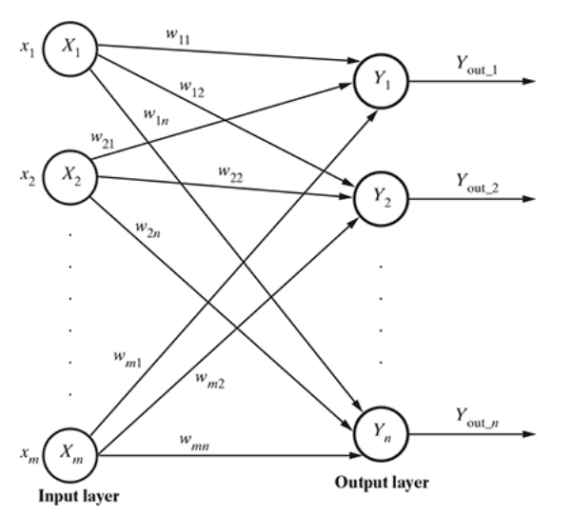
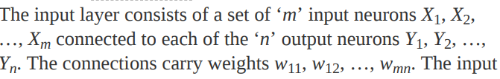

Single-layer feed forward network :
The input layer is fully connected to the output layer. having only one weighted layer.
the signals always flow from the input layer to the output layer. Hence, this network is known as feed forward.

Slide 71


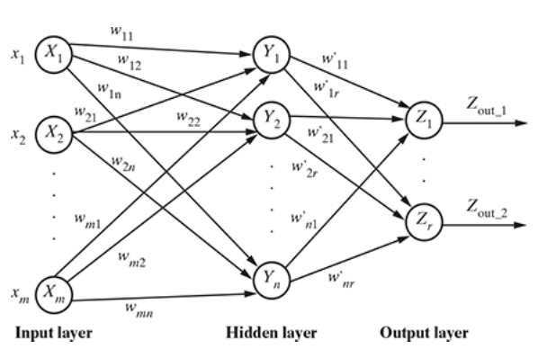
Multi-layer feed forward ANNs:
there are one or more intermediate layers of neurons between the input and the output layers. it is called hidden layers.
Hence, the network is termed as multi-layer
The net signal input to neuron in the hidden layer is
The net signal input to neuron in the output ayer is

Slide 72
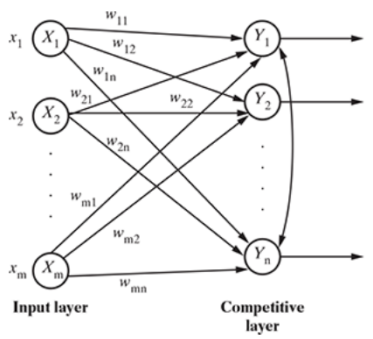
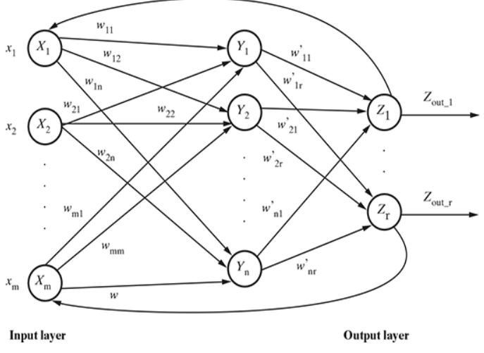
Competitive network:
The competitive network is almost the same in structure as the single-layer feed forward network. The only difference is that the output neurons are connected with each other (either partially or fully).
Recurrent network :
We have seen that in feed forward networks, signals always flow from the input layer towards the output layer (through the hidden layers in the case of multi-layer feed forward networks), i.e. in one direction. In the case of recurrent neural networks, there is a small deviation. There is a feedback loop. There may also be self-loops

Slide 73
Problems

Slide 74
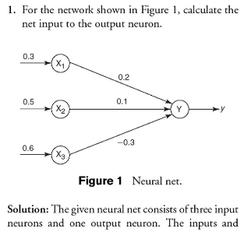
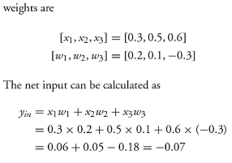

Slide 75
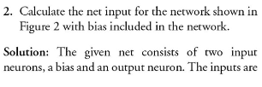
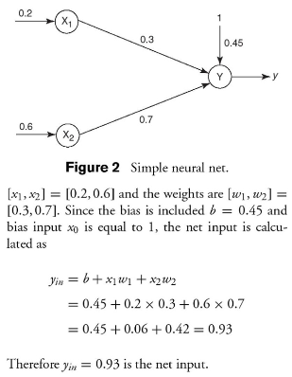

Slide 76
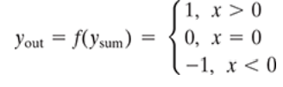
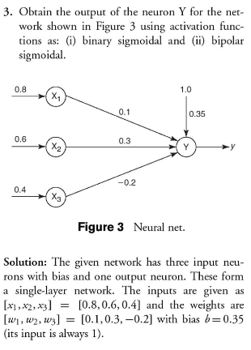
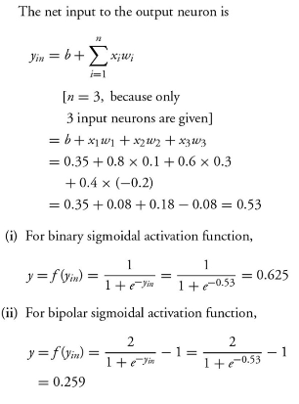
Applying activation function

Slide 77
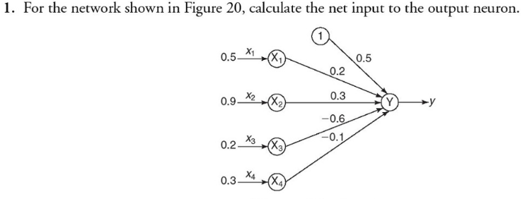
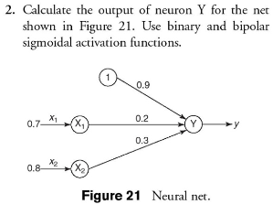
Find the net input

Slide 78
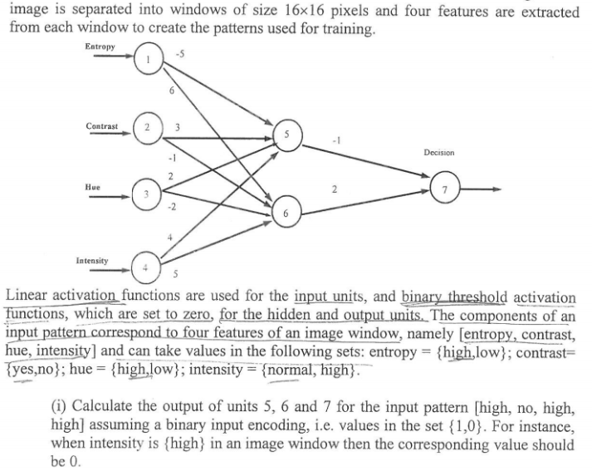

Slide 79
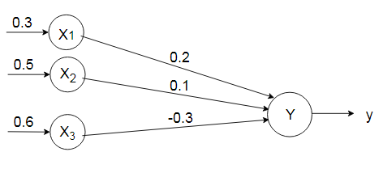
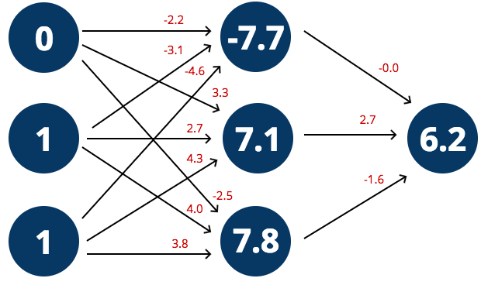
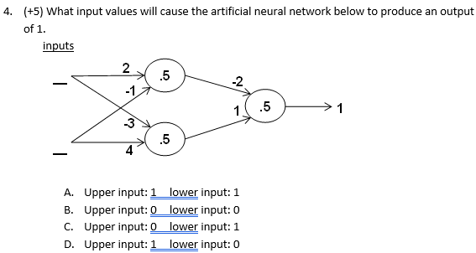

Slide 80
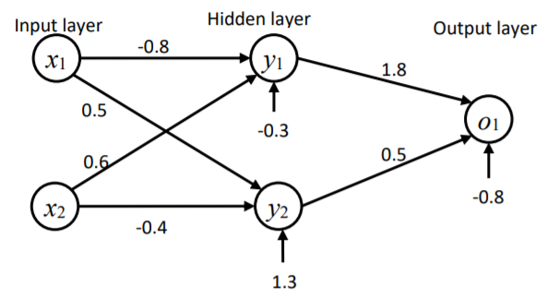
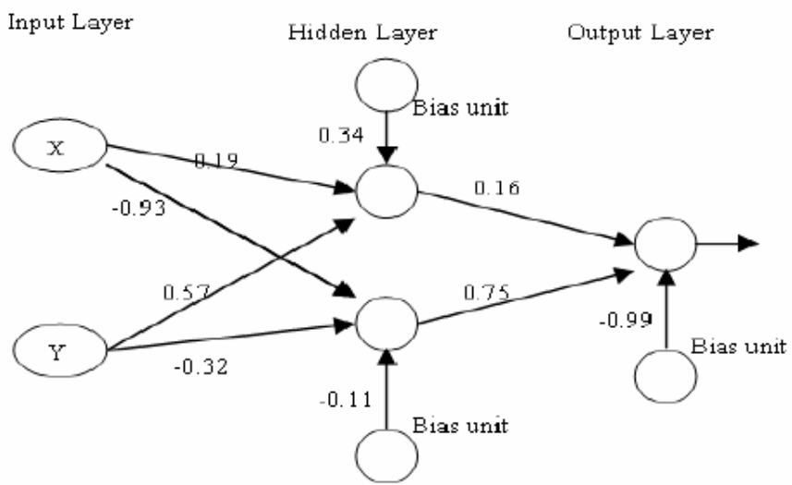

Slide 81
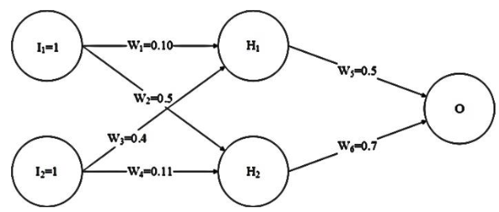
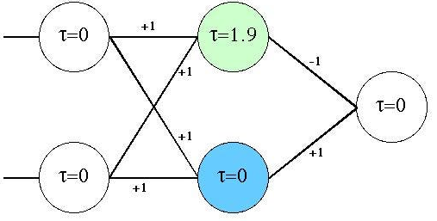

Slide 82
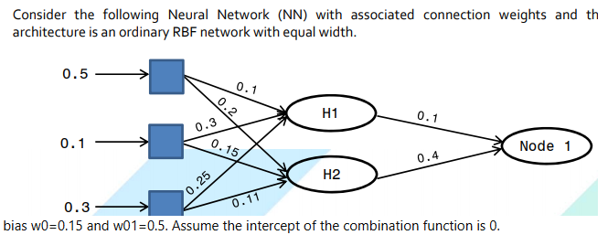
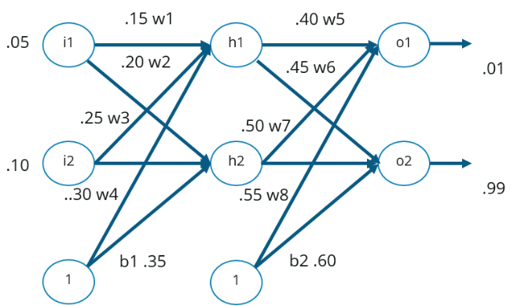

Slide 83
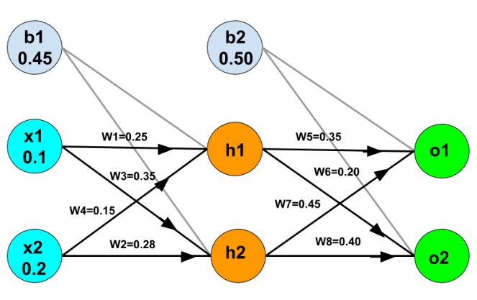
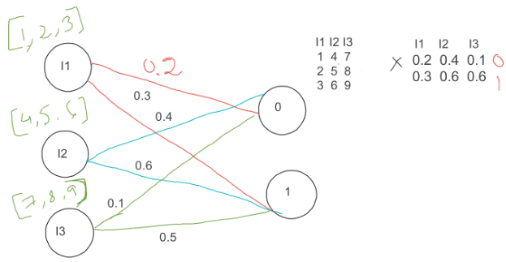

Slide 84
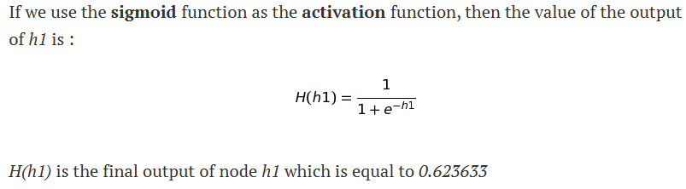

Slide 85
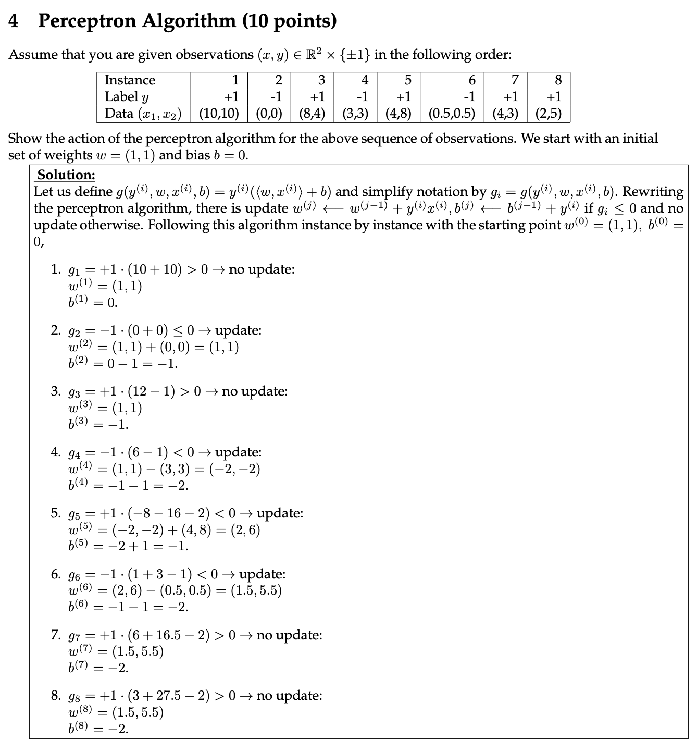

Slide 86
Activation Function
is a mathematical function applied to the output of a neuron.
use activation functions to propagate the output of one layer’s nodes forward to the next layer (up to and including the output layer).
use in the hidden layer as well as at the output layer of the network.
to introduce non-linearity into the model, allowing the network to learn and represent complex patterns in the data

Slide 87

Linear :the equation similar to as of a straight line i.e. y = x,
Range : -inf to +inf
Uses : Linear activation function is used at just one place i.e. output layer.
Sigmoid : Equation : A = 1/(1 + e^{-x})
Nature : Non-linear.
Value Range : 0 to 1
Uses : Usually used in output layer of a binary classification, where result is either 0 or 1, as value for sigmoid function lies between 0 and 1 only so, result can be predicted easily to be 1 if value is greater than 0.5 and 0 otherwise.
Tanh : Tangent Hyperbolic function.
f(x) = tanh(x) = 2/(1 + e-2x) – 1 OR tanh(x) = 2 * sigmoid(2x) – 1
Value Range :- -1 to +1
Nature :- non-linear
Uses :- Usually used in hidden layers
Hard Tanh: Similar to tanh, hard tanh simply applies hard caps to the normalized range. Anything more than 1 is made into 1, and anything less than –1 is made into –1. It is a cheaper and more computationally efficient version of the tanh activation.
Softmax:
The softmax function is also a type of sigmoid function but is handy when we are trying to handle multi- class classification problems.
Nature :- non-linear
Uses :- Usually used when trying to handle multiple classes. the softmax function was commonly found in the output layer of image classification problems.
The softmax function would squeeze the outputs for each class between 0 and 1 and would also divide by the sum of the outputs.
Output:- The softmax function is ideally used in the output layer of the classifier where we are actually trying to attain the probabilities to define the class of each input.
ReLU : Rectified linear unit.
Equation :- A(x) = max(0,x). It gives an output x if x is positive and 0 otherwise. implemented in hidden layers
Value Range :- [0, inf)
Nature :- non-linear, which means we can easily backpropagate the errors and have multiple layers of neurons being activated by the ReLU function.
Uses :- ReLu is less computationally expensive than tanh and sigmoid because it involves simpler mathematical operations.. RELU learns much faster than sigmoid and Tanh function.

Slide 88

Leaky ReLU:
Softplus : smooth version of the ReLU.
(f(x) = ln[ 1 + exp(x) ])
The basic rule of thumb is if you really don’t know what activation function to use, then simply use RELU as it is a general activation function in hidden layers and is used in most cases these days.
If your output is for binary classification then, sigmoid function is very natural choice for output layer.
If your output is for multi-class classification then, Softmax is very useful to predict the probabilities of each classes.

Slide 89




Most commonly used
Step
Sigmoid
ReLU
Softmax

Slide 90
What Is Meant by "ReLU Doesn’t Restrict Output"?
Most activation functions compress (squash) their outputs to a limited range (like 0–1 or -1 to 1). But ReLU doesn’t do that — it can output:
0 for negative inputs
Any positive value for positive inputs (no upper limit)
So, if the input is 1000, ReLU just gives 1000 (not squashed or compressed).
What Is “Vanishing Gradient”?
A gradient is like the slope that tells the model how much to change the weights during learning.
Vanishing Gradient Problem:
In deep networks, when using activation functions like sigmoid or tanh, the gradients (slopes) become very small in deeper layers.
When you multiply these small gradients many times (in backpropagation), they become almost zero.
This makes the weights stop updating — and the model stops learning.
This is called the vanishing gradient problem.
What Is “Squashing”?
Squashing means compressing the output into a small range.
Examples:
Sigmoid: squashes input into (0, 1)
Tanh: squashes input into (-1, 1)
Squashing helps keep values in control but also causes small gradients (slopes) for big inputs — which leads to vanishing gradients.
So Why Is ReLU Better?
ReLU does not squash positive values.
It keeps strong gradients for positive inputs.
This helps deep networks learn faster and better — especially when there are many layers.

Slide 91
Loss function
A loss function is a method used to measure how wrong your model's prediction is compared to the actual (true) value.
It tells the model how far off its predictions are from the expected output.
A loss function is a function that compares the target and predicted output values; measures how well the neural network models the training data.
When training, we aim to minimize this loss between the predicted and target outputs.
The hyperparameters are adjusted to minimize the average loss — we find the weights, wT, and biases, b, that minimize the value of J (average loss).
Example:
Imagine you're predicting house prices.
True price: ₹10 lakhs
Model prediction: ₹7 lakhs
The loss = difference between actual and predicted = ₹3 lakhs
This “difference” is what the loss function calculates in mathematical form.
Why Is Loss Function Important?
It helps the model understand its mistakes
Goal of training: Minimize the loss over time

Slide 92

Types
Binary Cross-Entropy
Used for binary classification (e.g., 0 or 1, Yes or No)
loss='binary_crossentropy'
Categorical Cross-Entropy
Used for multi-class classification where outputs are one-hot encoded
loss='categorical_crossentropy‘]
One-hot encoding is a method to convert categorical (non-numeric) values into numeric vectors so that they can be used in machine learning models.
It creates a binary vector (full of 0s and one 1) for each category.
Sparse Categorical Cross-Entropy
Used for multi-class classification but with integer labels instead of one-hot
loss='sparse_categorical_crossentropy'
Mean Squared Error (MSE)
Used in regression problems (predicting numbers)
loss='mean_squared_error'

Slide 93
Loss Function for regression
Mean Squared Error Loss Function
Mean Absolute Error Loss
Mean Absolute Percentage Error loss
Mean Squared log error loss

Slide 94
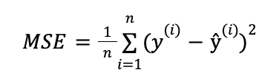

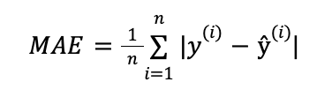
Mean Squared Error Loss Function:
sensitive to outliers in the data, making it less suitable for some tasks.
Mean Absolute Error (MAE)
MAE finds the average of the absolute differences between the target and the predicted outputs.

Slide 95

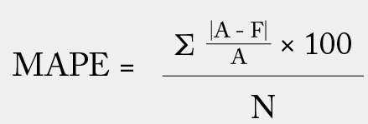
Mean Squared Logarithmic Error Loss
Mean squared logarithmic error (MSLE) loss is a function used for regression tasks. It is similar to mean squared error (MSE) loss, but it takes the logarithm of the predicted output before squaring the difference between the predicted and true values.
The following equation gives the MSLE loss
Mean Absolute Percentage Error (MAPE) or mean absolute percentage deviation (MAPD)
Where:
N is the number of fitted points;
A is the actual value;
F is the forecast value; and
Σ is summation notation (the absolute value is summed for every forecasted point in time).

Slide 96

Loss Function for classification
Binary classification loss functions in neural networks are functions that are used to evaluate the performance of a machine learning model on a binary classification task. Binary classification is a machine learning task involving predicting a binary outcome, such as a Yes/No decision or a 0/1 label.
Binary Cross-Entropy:
Binary cross-entropy loss is a loss function used for binary classification tasks. It is defined as the negative log probability of the true class. It is calculated by taking the negative log of the predicted probability of the true class.
The mathematical formulation for binary cross-entropy loss is:
Hinge Loss: (mostly for binary clsssification)
Hinge loss is a function that trains linear classifiers, such as support vector machines (SVMs). It is the maximum difference between the predicted and true margins and a constant value. The predicted margin is the distance between the decision boundary and the closest training data point. The true margin is the distance between the decision boundary and the true label.
The following equation gives the hinge loss:
Hinge Loss=𝑚𝑎𝑥(0,1−𝑦𝑡_{𝑟𝑢𝑒}∗𝑦_{𝑝𝑟𝑒𝑑})Hinge Loss=max(0,1−y_{true}​∗y_{pred}​)

Slide 97
Logistic loss
Negative log likelihood

Slide 98

Loss function for Reconstruction
The reconstruction loss, on the other hand, is pivotal in unsupervised learning, particularly in models like autoencodersthat learn efficient data coding in an unsupervised manner. This loss function measures how well the output of the model can reconstruct the original input data after being encoded and decoded.
Kullback-Leibler (KL) divergence, or relative entropy, is a metric used to compare two data distributions. It is a concept of information theory that contrasts the information contained in two probability distributions.
Divergence in Statistics
The divergence between two probability distributions quantifies how much the two differ from each other.

Slide 99
RBM
A Restricted Boltzmann Machine (RBM) is a generative stochastic neural network that can learn a probability distribution over its set of inputs.
RBMs are building blocks for Deep Belief Networks (DBNs) and are primarily used for dimensionality reduction, feature learning, collaborative filtering, and pretraining deep networks.

Slide 100
What is an RBM?
An RBM is a two-layer neural network that is undirected and bipartite(because of only two layers conencted with each other and no interconnection within the same layer), consisting of:
Visible layer (v): Input layer
Hidden layer (h): Extracts features or latent representations . Hidden units are feature detectors, learning features from the input data.
No intra-layer connections: Neurons within the same layer are not connected.
RBMs are called “restricted” because of this restriction of no intra-layer connections, which simplifies computation and learning.

Slide 101
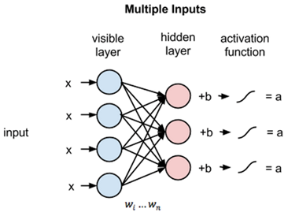

Slide 102
Training
The technique known as pretraining using RBMs means teaching it to reconstruct the original data from a limited sample of that data. RBMs learn to reconstruct the input dataset.
Reconstruction
Deep neural networks with unsupervised pretraining (RBMs, autoencoders) perform feature engineering from unlabeled data through reconstruction.
In pretraining, the weights learned through unsupervised pretrain learning are used for weight initialization in networks such as Deep Belief Networks.

Slide 103
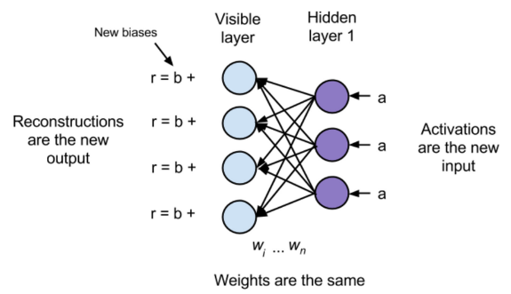

Slide 104
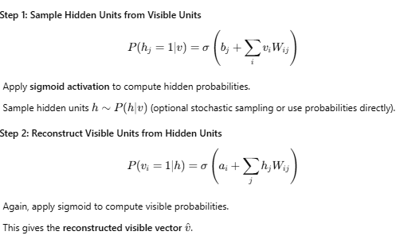
How to Perform Reconstruction in a Restricted Boltzmann Machine (RBM)
Reconstruction is a key step in RBM training. It refers to the process of trying to recreate the original input after passing it through the hidden layer and back again. This helps the RBM learn useful representations by minimizing the difference between original and reconstructed input.
Reconstruction Workflow (Forward and Backward Pass)
Let’s say you start with an input vector v.

Slide 105
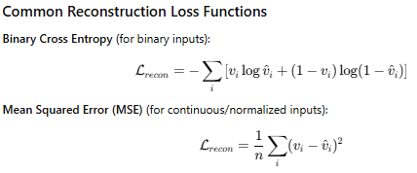
Purpose of Reconstruction
Compare the original input v and the reconstructed input v’.
Compute reconstruction loss, often mean squared error or cross-entropy loss, to train the RBM using Contrastive Divergence.

Slide 106
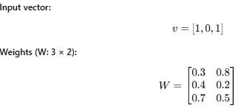
Sample RBM Architecture
Visible units (input layer): 3 units (v₁, v₂, v₃)
Hidden units (feature layer): 2 units (h₁, h₂)
Let’s define:
Input vector:
Each row corresponds to a visible unit; each column to a hidden unit.
Biases:
Hidden layer biases: b=[0.1,0.2]
Visible layer biases: a=[0.05,0.05,0.05]

Slide 107

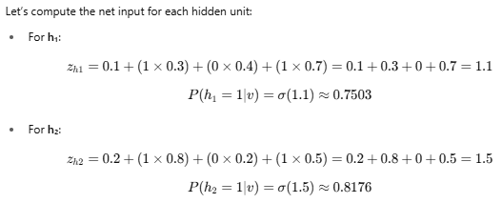

Step-by-Step Reconstruction
Step 1: Forward Pass — Compute Hidden Probabilities
Using:

Slide 108
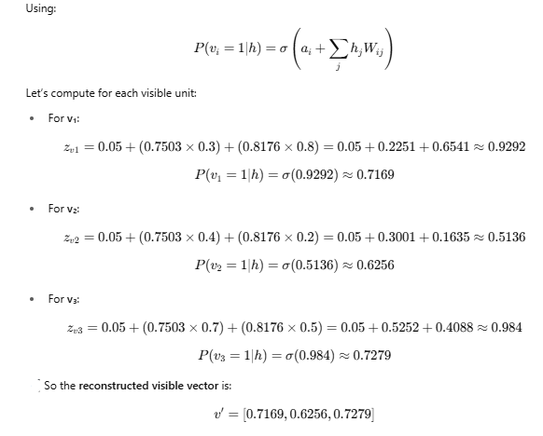

Slide 109



Slide 110


Slide 111


